Slide 1
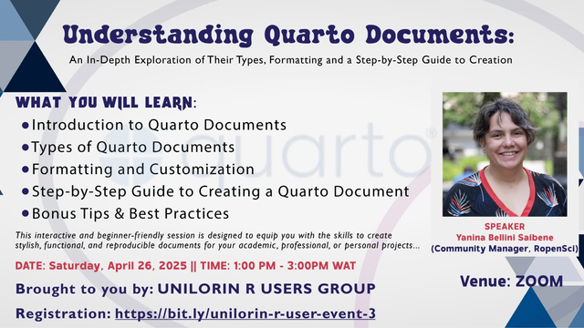
Understanding Quarto Documents

Slide 2
About me
- Community Manager, rOpenSci
- Developer Educator, Austral University
- Board of Directors, R-Ladies and The Carpentries
- Co-founder and co-char LatinR
- R Markdown user for 7 years
- Quarto user for ~2 years

Slide 3
About me About you
- Community Manager, rOpenSci
- Developer Educator, Austral University
- Board of Directors, R-Ladies and The Carpentries
- Co-founder and co-char LatinR
- R Markdown user for 7 years
- Quarto user for ~2 years
Please share on the chat:
What do you use R for?

Slide 4
This event is for someone who
knows some R
has worked in RStudio
wants to learn about Quarto

Slide 5
This event is for someone who
knows some R
has worked in RStudio
wants to learn about Quarto
I’ll teach you
What is Quarto
Components of a Quarto Document
Type of documents and their setup
Specific features: markdown, code blocks, plots and figures, callouts, tables

Slide 6
Hello Quarto!
What is this all about?

Slide 7
Download and install the latest versions of R, RStudio, and Quarto:
R: https://cran.r-project.org
RStudio: https://posit.co/download/rstudio-desktop
Quarto: https://quarto.org/docs/download
For this event you can also use Posit Cloud with this project:
https://posit.cloud/content/10257752
What do you need to use Quarto?

Slide 8
Question
Answer on the chat with yes or not:
Have you used RMarkdown?

Slide 9
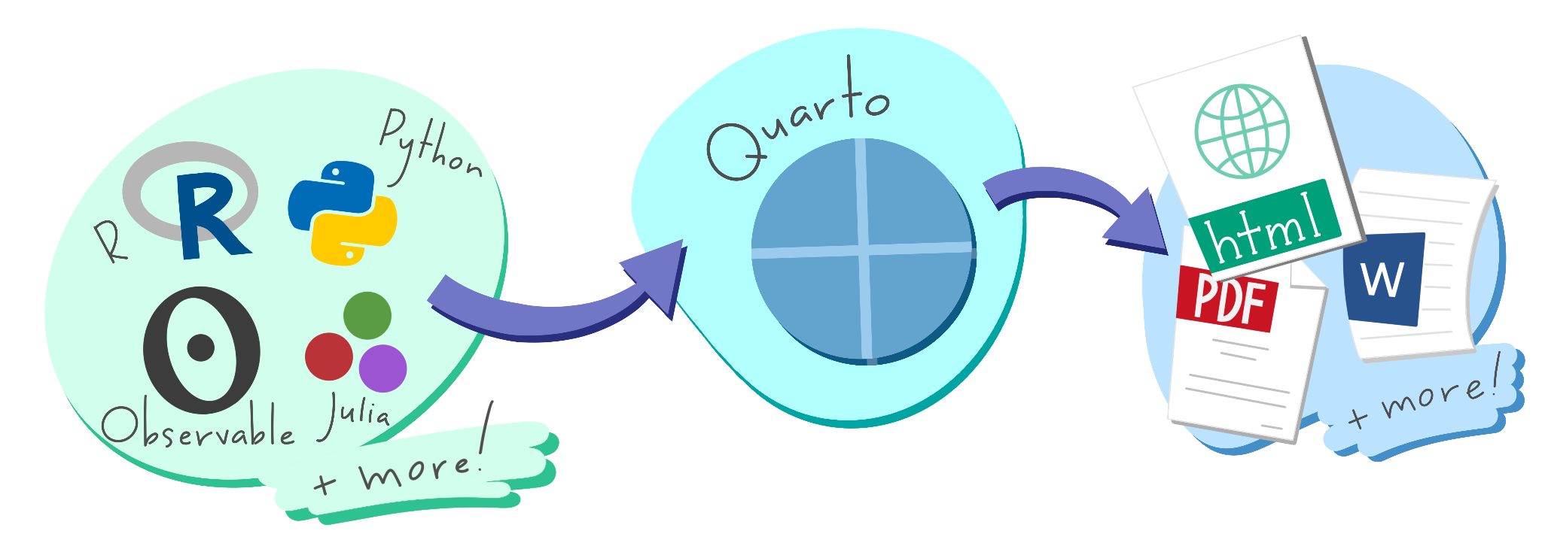
Quarto …
is a new, open-source, scientific, and technical publishing system.
Illustrated by Allison Horst.

Slide 10
With Quarto you can weave together narrative text and code to produce elegantly formatted output as documents, web pages, blog posts, books and more
https://quarto.org/docs/gallery/

Slide 11
Let's do a Quarto Tour in RStudio

Slide 12
Components of a Quarto Document
Metadata: YAML
Text: Markdown
Code: Executed via knitr or jupyter

Slide 13
“Yet Another Markup Language” or “YAML Ain’t Markup Language” is used to provide document level metadata
in key-value pairs,
that can nest,
are fussy about indentation,
and are kept between ---.
---
key: value
---
Definitive list: quarto.org/docs/reference/formats/html

Slide 14
Many output formats + programming languages
HTML reports and websites
PDF reports
MS Office (Word, Powerpoint)
Presentations (Powerpoint, Beamer, revealjs)
Books
Any language, exact same approach and syntax

Slide 15
Let's check the different part of a document and try different type of documents in RStudio

Slide 16
Where we can learn more?
Installing Quarto
Official Documentation
Slides: Emil Hvitfeldt’s Series Slidecraft 101
Branding your Quarto Project by Isabella Velasquez

